Slide 1
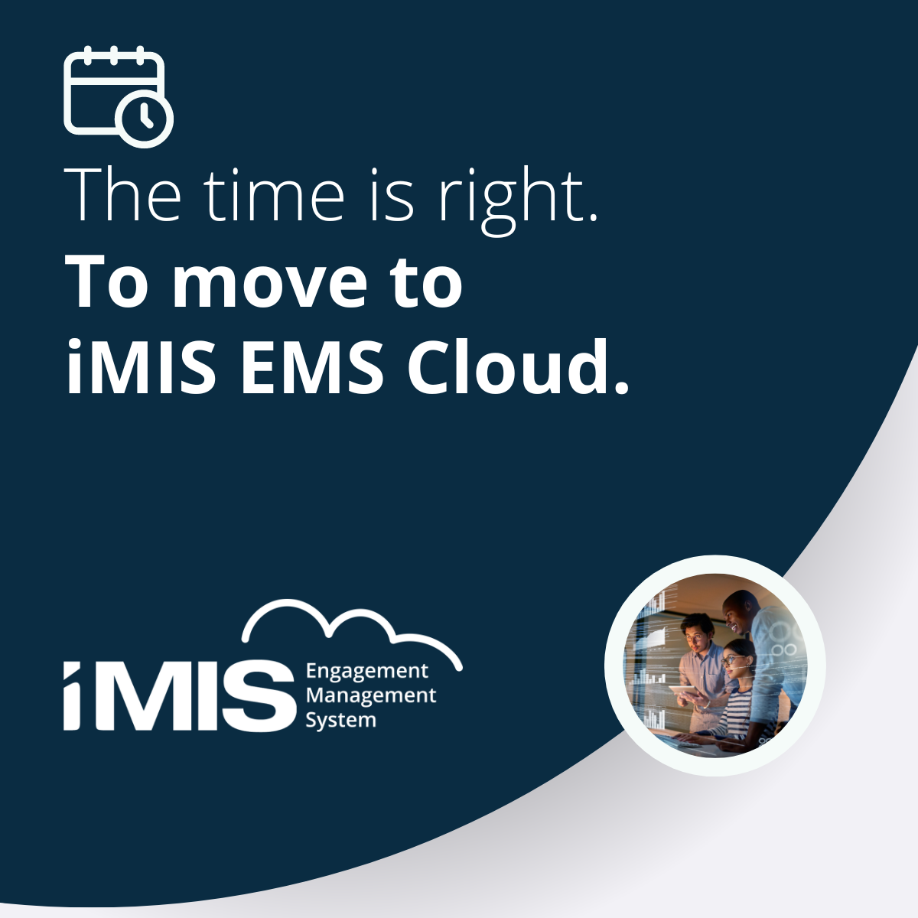


Notes:
A

Slide 2

Now is the time to plan
Notes:
No matter where your organization is on the decision towards upgrading iMIS, now is definitely the time to start your plan for this transformation. You’ve likely heard this line before - and you will hear it again later on in our presentation, but this will be your last upgrade in iMIS.

Slide 3



About Visual Antidote
  Founded in
  2006
  Number of Staff
  18
  Located in
  Toronto, Canada
Authorized iMIS Consultants (AiC)
of the Year for 2021
Now Authorized iMIS Solution Provider (Nov 2022)
Notes:
Allow me to take a few moments to talk a bit about us - we’re Visual Antidote, we were founded in 2006 by our president and CEO, Keith Stoute. We are now up to 18 employees, located in Toronto, Ontario, but with a few in Western Canada, Keith included, and a long time employee situated overseas. In 2021, we were awarded ASI’s Authorized iMIS Consultants of the year and we have recently matured to become an Authorized iMIS Solution Provider with ASI as of November of 2022.

Slide 4
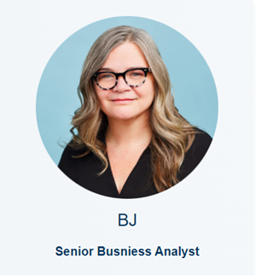
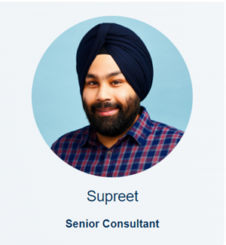
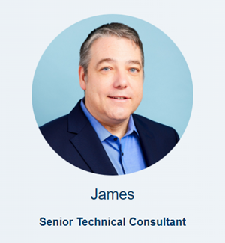
What we’ll cover
Agenda
How is iMIS changing?
What’s new in iMIS?
Upgrade options (there’s more than one way)
Our Visual Antidote upgrade approach
Managing costs
How we can help
Notes:
Here is our agenda for the webinar today - I’m going to start the presentation off with a brief overview of “What’s changing in iMIS” and reasons to consider upgrading to EMS, and then cover some of the new features in the EMS platform. I’ll then hand it over to my college Supreet, to cover the different upgrade paths - there are more than one - and our recommendation and approach with our client base. Supreet will then hand the conversation over to James review how you can manage the costs and how we can help.

Slide 5

How is iMIS Changing?

Slide 6


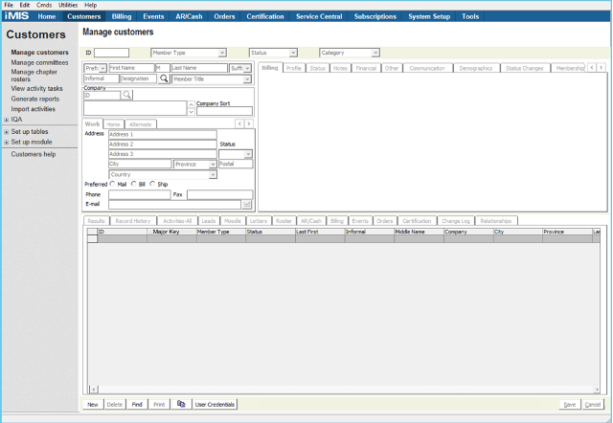
Self Managed
iMIS 2017
  Manual iMIS updates
  Security patches your responsibility
  PCI compliance your responsibility
  Hardware / Hosting costs
  No new enhancements for iMIS 2017
  Requires iMIS to be installed on employee workstation - with RDP access to work remotely
  Outdated User interface
  Requires some tasks to be done half in desktop and half in staff site
Notes:
The EMS version of iMIS is ASI’s fully cloud based offering. Sometimes people get confused on what these means as the conversation tends to revolve around self-hosted vs cloud hosted and your Organization is possibly working with hosting provider such as E-Tech, ATS or even ASI to deliver access to your version of the iMIS application. However the distinction is really between being on a self managed environment vs a cloud managed environment.
For iMIS 2017, you are on a self-managed version of iMIS. Any updates to iMIS are manually scheduled and managed by you, generally with the assistance of your AiC/AiSP and hosting provider. Security patches and PCI compliance are your responsibility. Hardware and Hosting fees are in addition to your iMIS licensing fees. Most importantly, there are no new enhancements or features coming for iMIS 2017. iMIS 2017 still requires the application to be installed on an employee workstation or on terminal server with remote access for staff to connect to iMIS. The user interface is now outdated with some information in tabs difficult to view and some task still require desktop access or can be done half in desktop and half in staff site.

Slide 7

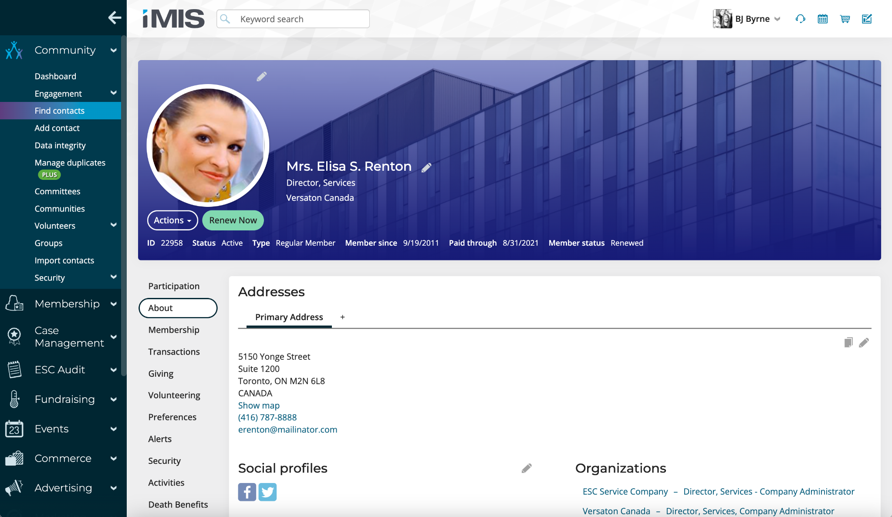

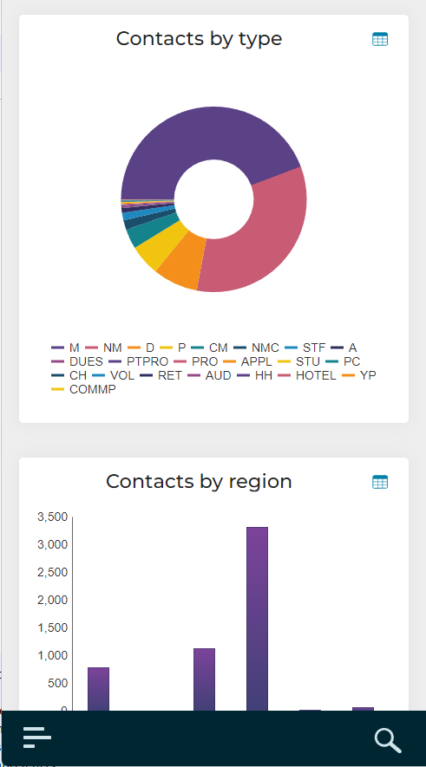
Cloud
Automatic updates
Security is always up to date
PCI Compliance handled by ASI
Hardware/Hosting included in iMIS License
Receive new features & new tools 2 to 3 times a year
Access iMIS from any web browser
More Flexibility – customizable panel interfaces
All features are available through the staff site
  Use your iMIS budget for
  improvements not patches
Notes:
For iMIS EMS platform is cloud managed platform. Updates to your system are automatic and routinely scheduled. Security is always up to date. ASI has also taken over the PCI Compliance of your system, reducing the burden of PCI Compliance requirements for your organization. Hardware and Hosting is now included in your iMIS License fees. But best of all, your version of iMIS will receive new features and tools automatically two to three times a year! All staff can access iMIS from any browser, anywhere. The staff site is flexible allowing you to create customizable interfaces using panels or even iMIS forms to improve your workflow in iMIS. And all features are available through the staff site.

Slide 8


What’s New in
Notes:
A

Slide 9
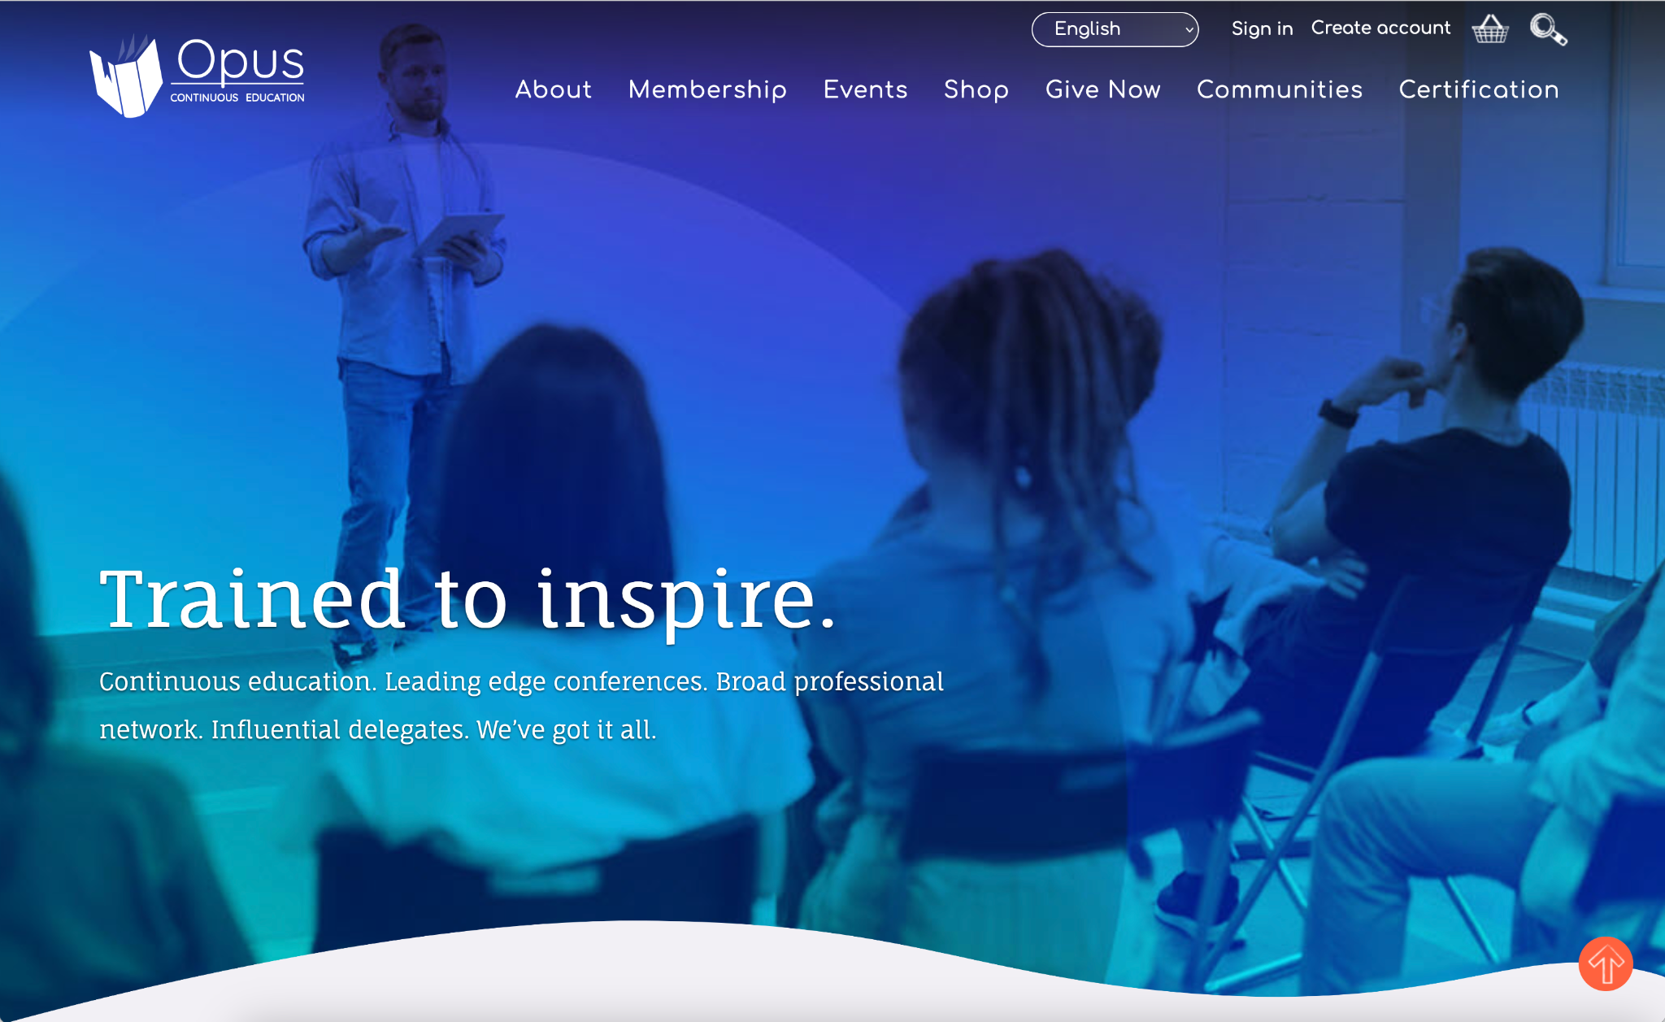

Website Tools Have Improved
Notes:
New and improved features in the EMS Platform make it easier to create a modern website managed by iMIS. EMS is optimized for mobile devices with responsive templates, page layouts, and widgets available to get you started.

Slide 10
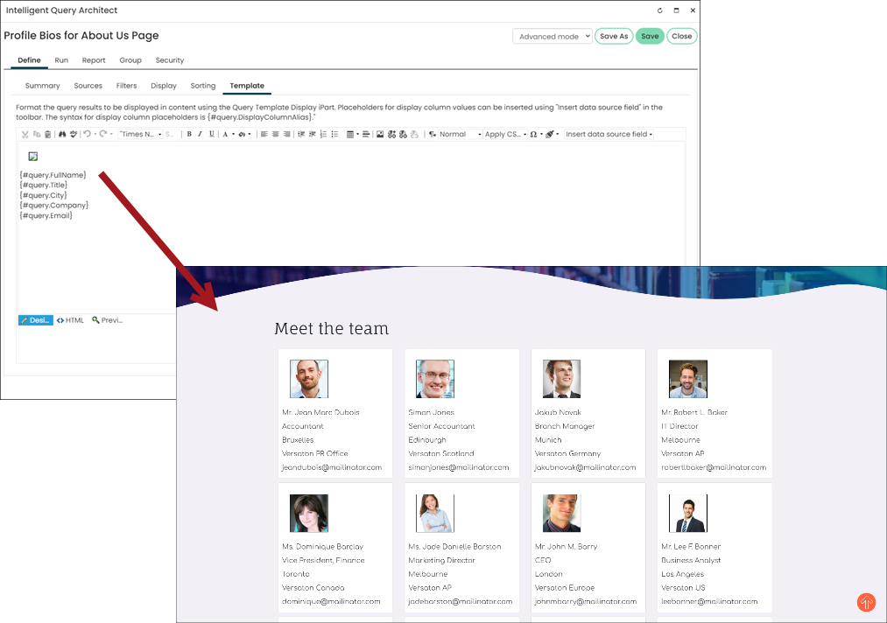
Dynamic Content
Notes:
There are new iParts that build off standard features you already know how to use in iMIS such as IQA templates. This is an iPart that will let you format repeating data from your site in a unique layout created by you, as an option to the standard list view of an IQA. This example is from the ASI Help showing how you can use this template to quickly create and display a group of users on your site, from your iMIS database. This could be your executive team with contact information or members of a committee. Because this is a based off an IQA query, you can decide what information to include in the display, but now have more control over how it appears on your website and ensure that the data included is consistent between each element.
EMS also has a robust API to allow you to integrate with a variety of web content management systems as needed.

Slide 11

Improved Security
Azure hosted
Continuous backups
Restore and recovery
CloudFlare Firewall
Improved protection against attacks
PCI Compliance
ASI manages this for you
Notes:
MIS EMS is hosted on Microsoft Azure which allows for continuous up to the minute backups and robust restore and recovery options. Should your organization be victim to a ransomeware attack, this security setup would allow you to recover your data from a time before the attack happened and get your organization up and running quickly without having to pay a ransomware fee.
ASI also uses CloudFlare to add an additional layer of protection - its a firewall that protects websites & applications from bots, distributed Denial of Service (DDoS) attacks and continuously monitors for suspicious activity & potential attacks. As also noted, ASI is reducing your PCI Compliance burden with their partnership with Global payments - while this doesn’t get your team fully off the hook, it does reduce the scope for your team.

Slide 12
New Features added with each upgrade
Events
Event Panels
Dynamic/Purchase Pricing Groups
Commerce
More Promotions options
Better visibility
Membership
Renew in Advance of Billing
Adjustments / Changes in Billing mid-term
Flexible Terms – quarterly etc.
Notes:
Events
There are now separate event tables - it allows greater flexibility in the data that can be captured for events.
There is a new feature on the staff site that makes it easy to see and manage dynamic IQA Groups created in iMIS on the staff site for better manageability.
Commerce
Promotion section has been expanded with more features. Promotions can be applied to membership dues for new members or members that are renewing in Advance. You can now set limits to your promotion codes, have promotion codes set to be applied automatically or have a discount based on the quantity of items purchased. Additionally, when a customer submits a promotion code, the cart is updated to include the code and discount received per line item in the cart
Membership
The Billing or membership section is fully online. It has many out of the box options to allow members to renew in advance of billing, for staff to make adjustments and changes in billing mid term as well as introducing flexible terms such as quarterly billing

Slide 13
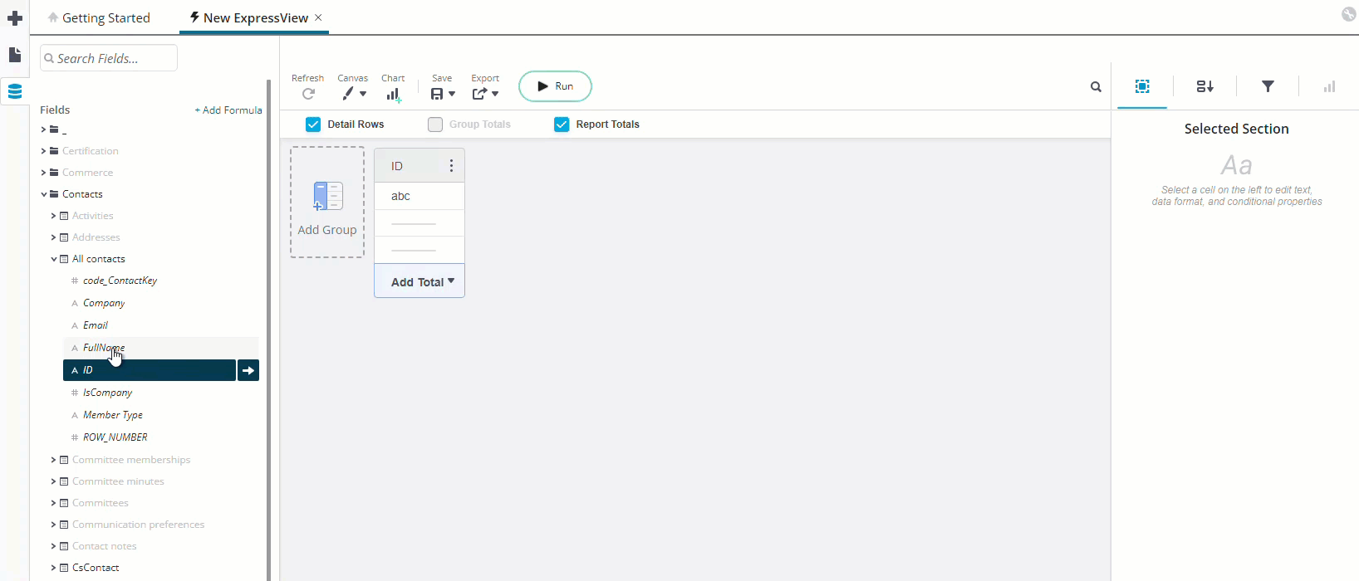
Report Writer
Replaces SSRS & Crystal
Many standard reports have been added already
Attach to communications
Notes:
The Report Writer tool is one of my favourite EMS features. This replaces SSRS and Crystal reports and provides iMIS users with a robust tool. ASI has included many standard reports with the system that will work with out of the box with your data in iMIS and do not require any tweaks. Additionally, for those of you who love to create reports, you’ll find that this is a robust tool that allows you to pull information from iMIS as you need it.

Slide 14
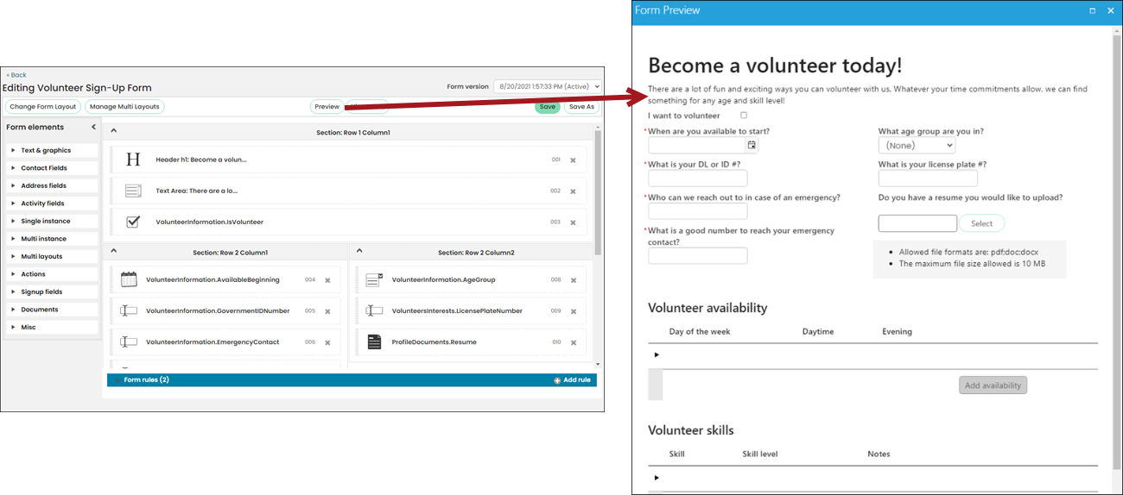
Replaces Sonic Forms
iMIS Forms
Notes:
We wouldn’t be Visual Antidote if we didn’t talk about Forms. The iMIS forms tool is obviously one of our favourites, but admittedly we are biased as we were involved in the initial development of this tool. IMIS forms replaces Sonic Forms and offers users an easy to use drag and drop form builder tool to create forms for your site in mobile friendly formats. The Rules Engine allows non-technical users to add automation to their forms to automate and control the data entry options.
There are a lot of other great features and tools for the EMS Version! Let’s talk about Upgrade options to get your organization on the planning path to EMS!

Slide 15
Upgrade Options

Slide 16

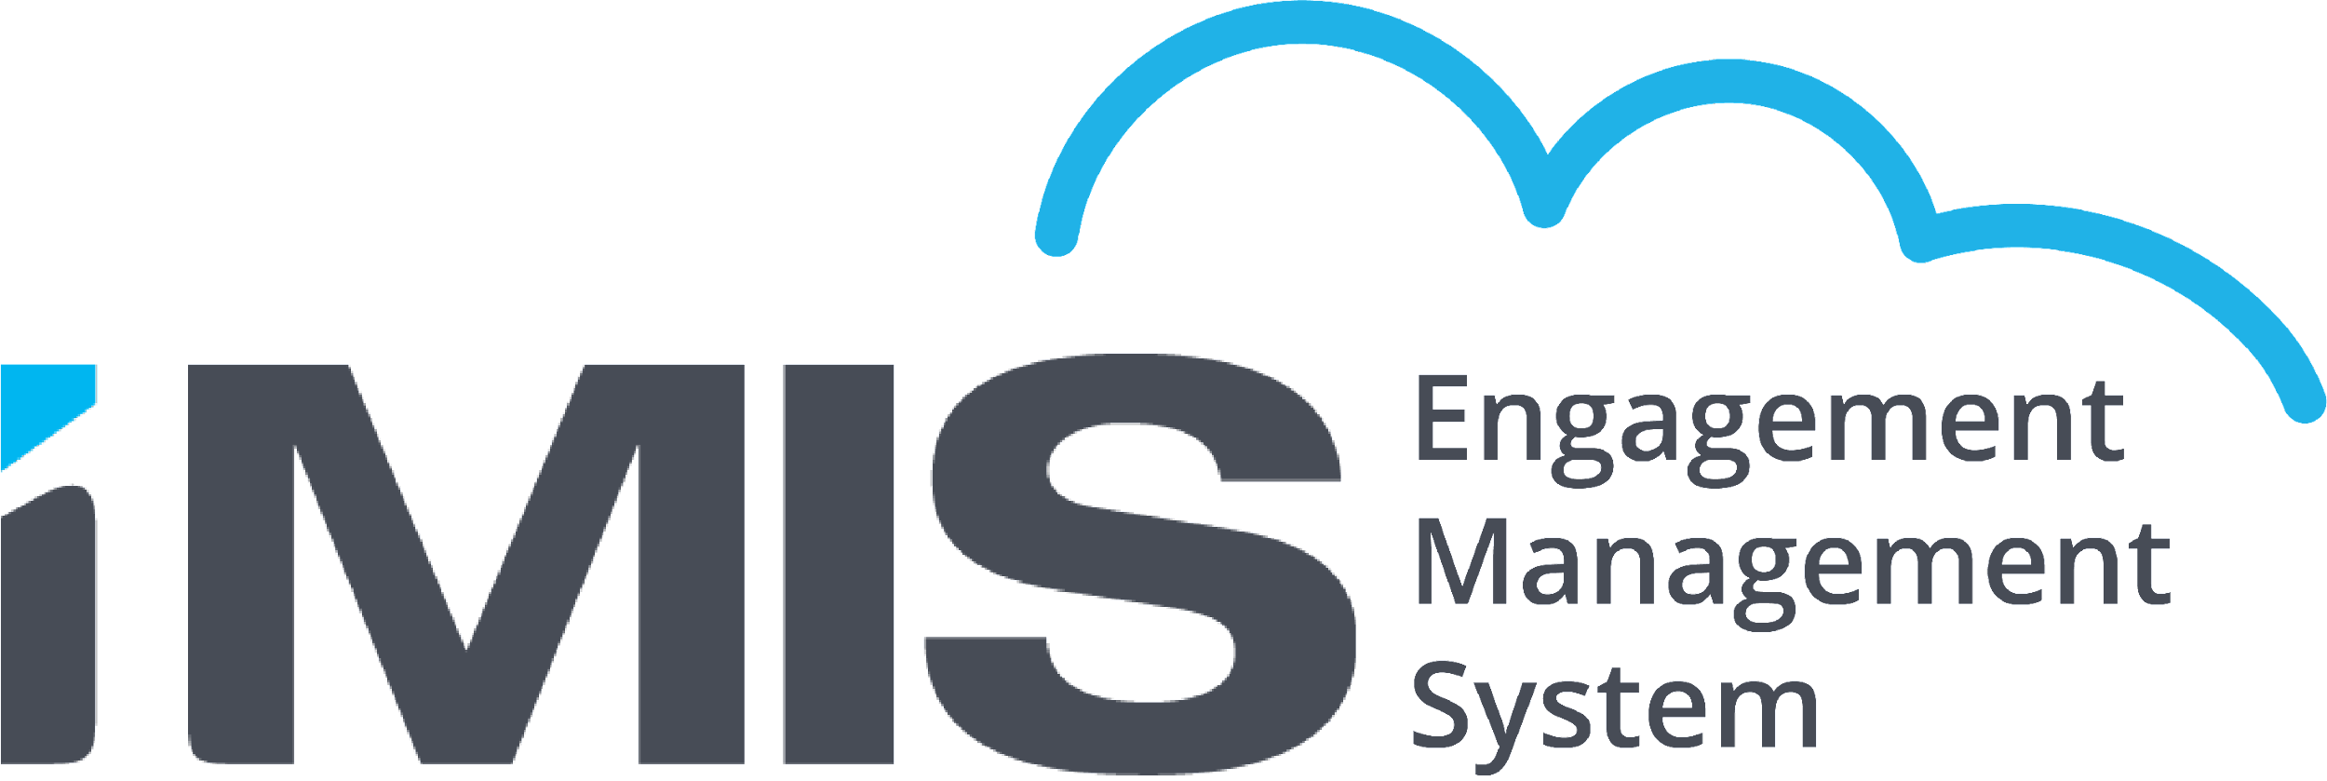


3 Options to Move to the Cloud
Option 1
Direct Upgrade / Straight to Cloud
Option 2
20/20 Advance Program / Retain SQL Access
Option 3
Self-Hosted / On Prem
*Must be on iMIS 2017’s latest service pack prior to upgrading.
  Which option is right for me?

Slide 17
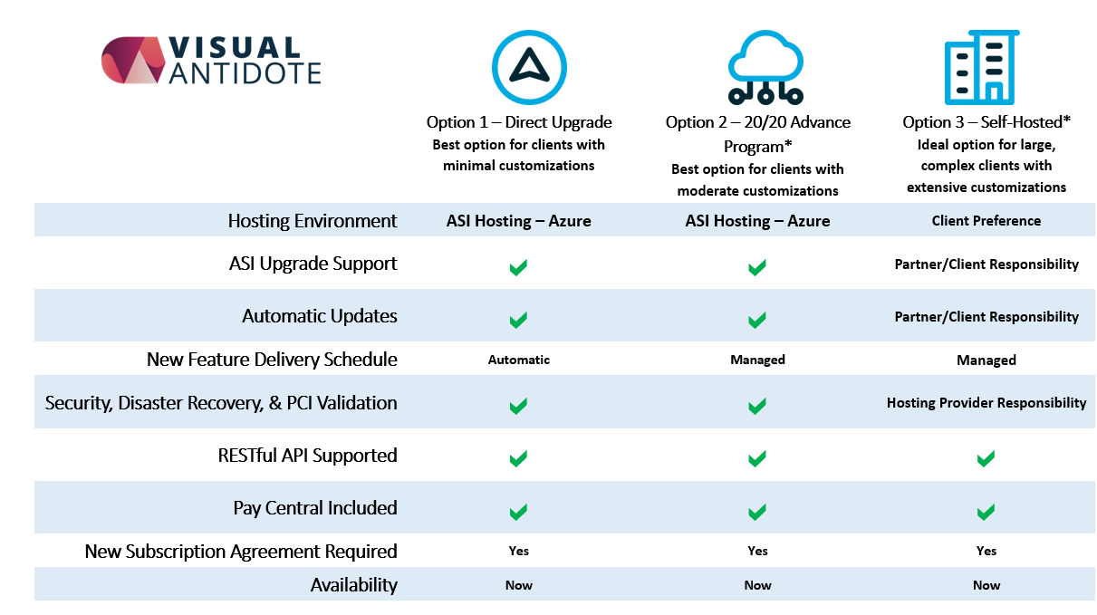

Slide 18

Here’s How
We’ll Do IT
Notes:
A

Slide 19
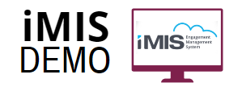
Discover What’s New in iMIS Cloud
Tailored Demonstrations:
  Every staff user touched by iMIS can attend
  Tour new features / tools
  Where Desktop features are now in Staff Site

Slide 20
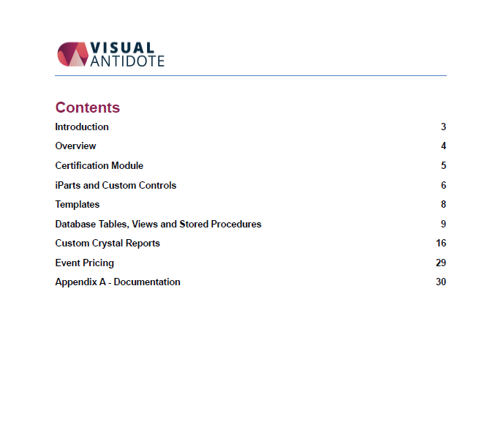



We will help you get there!
Analyse
  Cloud Audit / Review
Recommendations
  Choose & Plan the Right Option
Execute
  Using the option you choose
Notes:
Denis Grey to Everyone 1:41 PM
Migration of iMIS Data to New Instance
Migrate key processes ONLY and defer other parts until Cloud is running
Update / rebuild on iMIS 2017 to reduce upgrade effort
--> Option to do over more than one budget period

Slide 21

Analyse:
Cloud Audit
Identifies non-cloud compliant items
  Stored Procedures
  Crystal Reports etc.
  Custom iParts / Controls
2. Some modules have changed approach:
  Billing
  Event Pricing
  Certification

Slide 22
Recommendations:
Project Planning
Phase 1 iMIS 2017
What can be done before you upgrade to EMS
Phase 2 iMIS 20/20
1st stage of EMS upgrade
Phase 3 iMIS EMS
Final Stage of EMS upgrade
Crystal Reports -> IQA
Stored Procedures -> IDMS
Event Reg Classes
Desktop Tabs
Crystal Reports -> Report Writer
Rise Template
Accounting Setup
DB Tables
DB Stored Procedures
DB Views

Slide 23
Execute:
Complete the Paperwork with ASI
Database Preparation
Staging Environment Setup
Development and Testing
Launching iMIS EMS
Timeline: 3 - 6 months

Slide 24
Our Tools:
iMIS 2017 Sonic Form to iMIS EMS forms conversion tool
Documents Migration using Document Valet

Slide 25
Manage your Upgrade Costs

Slide 26

Regardless of when you upgrade… this will be the last upgrade you have to pay for in your iMIS Journey

Slide 27
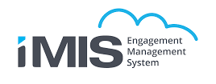

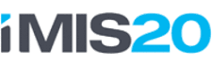

Your Last Upgrade
Evolution of the iMIS platform
Changes to the iMIS platform mean that regular expensive upgrades will no longer be needed.
Upgrades on iMIS EMS are done automatically by ASI and are included in your subscription price

Slide 28
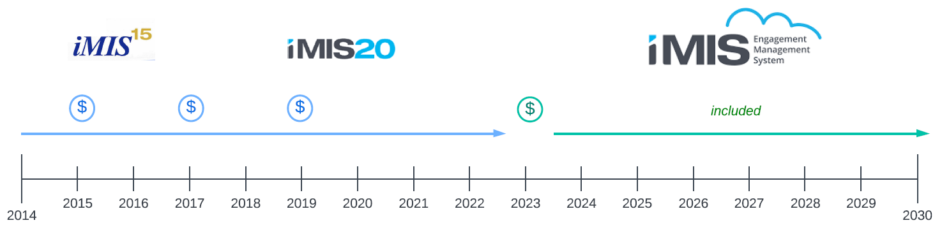
Upgrades Then vs. Now
In the past iMIS required expensive upgrades every 2 -3 years
With EMS upgrades are automatic and included in your subscription

Slide 29
There is more to this upgrade
Upgrade Complexity
This upgrade will likely be more complex and may be more expensive than previous upgrades
10 year old customizations need to be rebuilt
Custom Crystal Reports --> Report Writer
Event Registrant Classes --> Group pricing
Desktop custom tabs --> Staff Site Panels
Membership Special Pricing
Additional Training

Slide 30
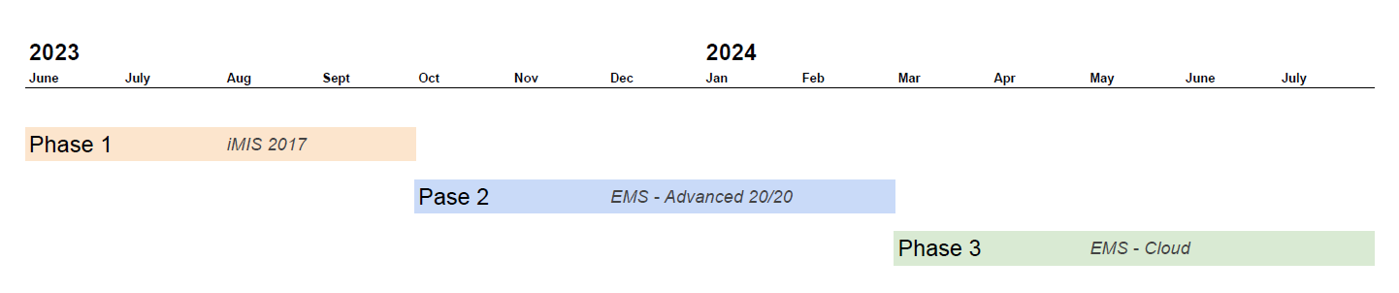
Phased Approach
The EMS upgrade options mean you can spread out your upgrade costs over multiple phases. Upgrade first to Advanced 20/20 then upgrade to full EMS Cloud the following year

Slide 31
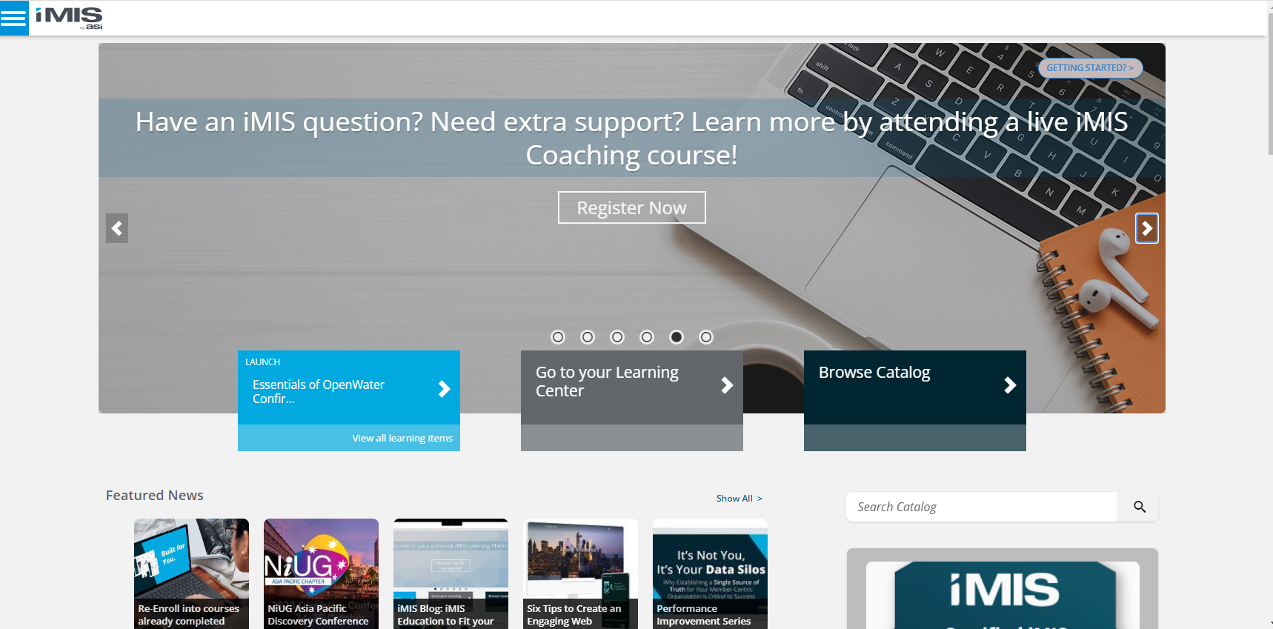
In House
Expert
Train one of your Key staff to become an iMIS In House Expert.
This staff member can:
Convert Desktop Tabs to Staff Site Panels
Convert Crystal Reports to Report Writer Reports
Setup Event Group Pricing
ASI Learning Hub is free for 1 year

Slide 32
Let Us Help You!

Slide 33
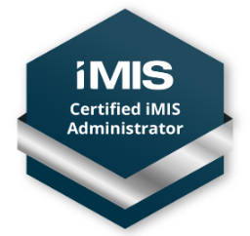

VA Staff are Here to Help
Visual Antidote Staff are trained and ready to help you. All of our staff are iMIS certified
Project management
iMIS Consulting
Business Analysis
Development

Slide 34

Change Management
Change Management is a team effort
Staff Training
Getting staff involved
Managing wish-list items
Prioritization
Staff buy-in to the project
In House iMIS Expertise

Slide 35

VA -iMIS Consultant for Hire
Managed Service
Consultant “on-tap”
iMIS Expertise to help fill gap
Tailored Training

Slide 36
In Short

Slide 37
We will help you get there!
Analyse
  Cloud Audit / Review
Recommendations
  Choose & Plan the Right Option
Execute
  Using the option you choose

Slide 38

Discussion
38
Notes:
Open

Slide 39
Thank you!
Notes:
Open

